Slide 1
Hepatite autoimune como evento adverso na imunoterapia para carcinoma hepatocelular
John Hart, MD
Universidade de Chicago, EUA

Slide 2
Declaração de Conflito de Interesse
Dr Hart não ter conflito de interesse a declarar
Em caso afirmativo, especificar: associação financeira relevante
nos últimos 12 meses e que esteja relacionada ao conteúdo da
atividade científica
Exigência da RDC Nº 96/08 da ANVISA

Slide 3
Clinical History
21-8689
68 year old F with metastatic melanoma, s/p ipilimumab and nivolumab treatment, with dramatic response
Developed immune-related panhypopituitarism, dermatitis, and increased LCTs
Switched to nivolumab monotherapy
TB = 2.7, AST = 777, ALT = 1225, alk phos = 180

Slide 4
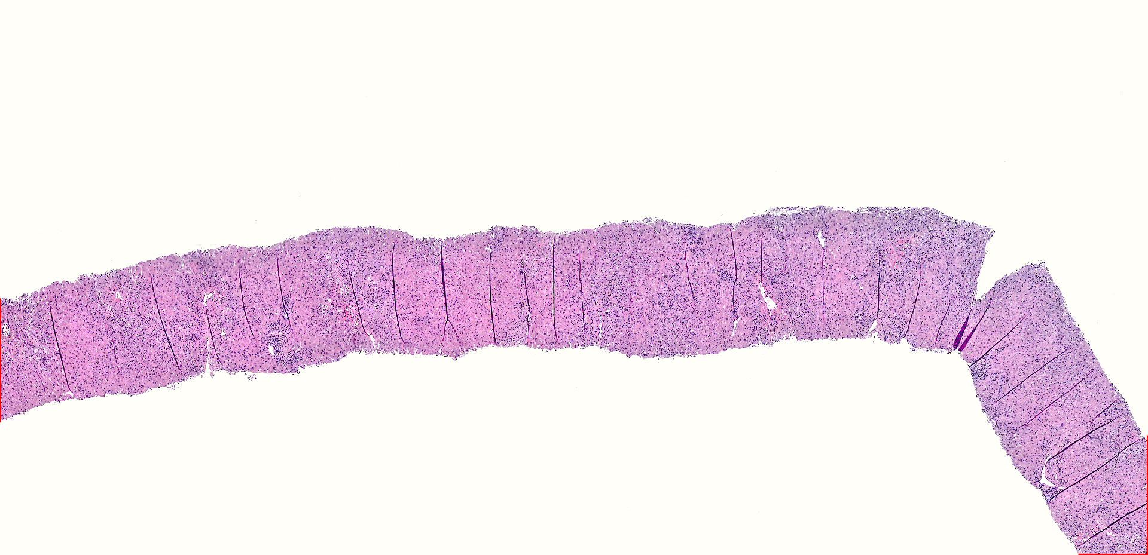

Slide 5
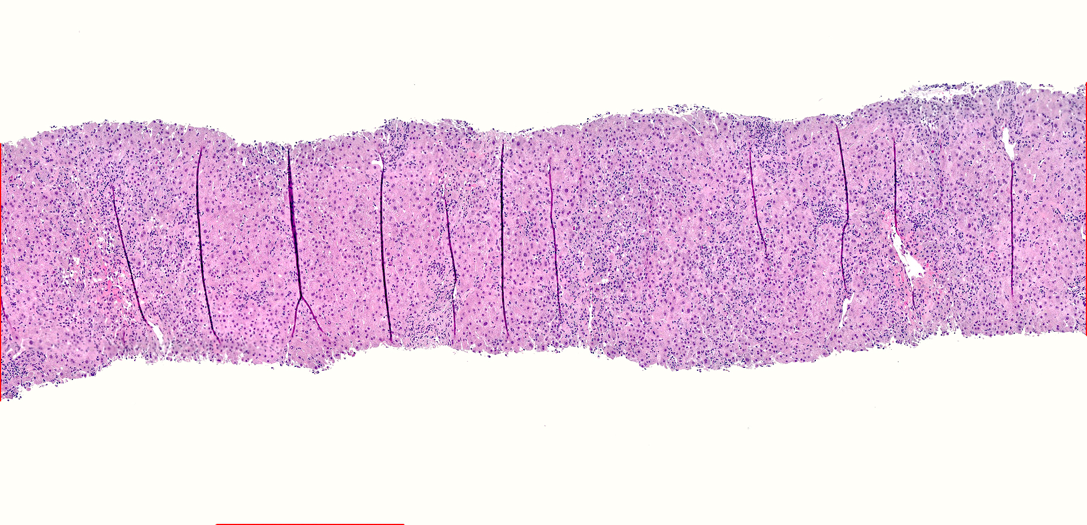

Slide 6
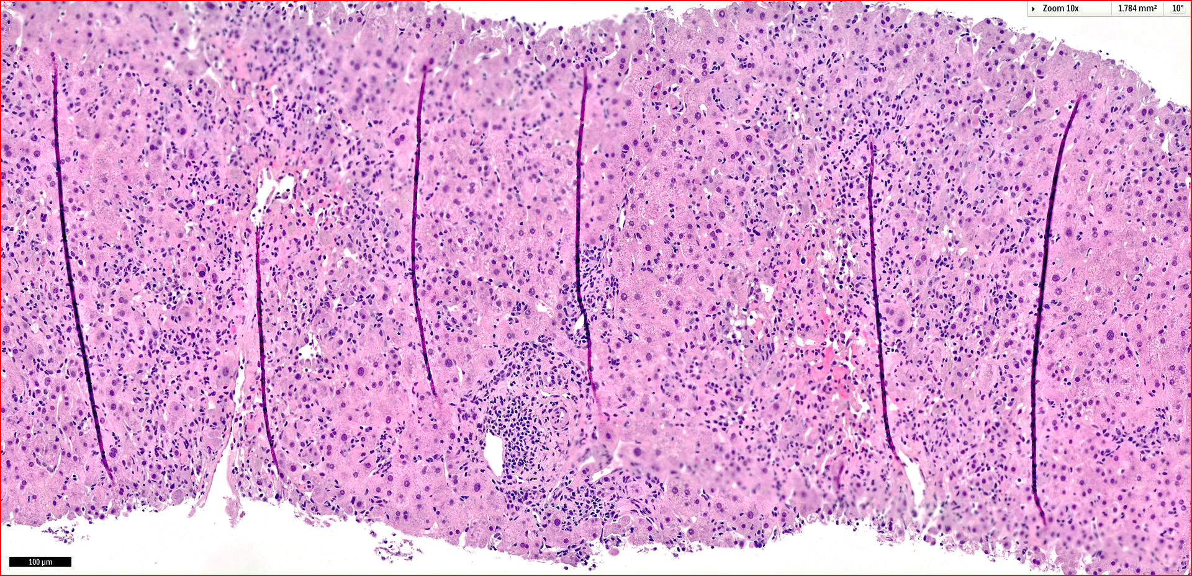

Slide 9
Varied Histologic Patterns of Checkpoint Inhibitor DILI
Multiple different checkpoint inhibitors
Multiple dosing regimes in various combinations
Prior chemotherapy
Presence of underlying chronic liver disease of various etiologies
Administration of numerous additional medications (e.g. antibiotics)
Malnutrition and parenteral nutrition

Slide 10
obrigado(A)!

Slide 13


Slide 14
All patients
HCC patients

Slide 15
Notes:
Trials for immunotherapy for HCC

Slide 16
Slide Title

Slide 17

Slide Title

Slide 18
Notes:
This is all kinds of transplants

Slide 19
Case History
16-28781
50 year old F s/p OLT in 1996 for cirrhosis due to NASH
In January, 2012 underwent wide local excision and sentinel node biopsy of scalp melanoma ( pT2a,N0, M0 )
Re-excision of recurrent scalp melanoma in August, 2016
CT scan reveals bilateral lung nodules and biopsy confirmed metastatic melanoma – cyclosporine dose reduced
NGS reveals TERT and BRAF p.V600K mutations
Mekinist and dabrafenib started (kinase inhibitors)
Notes:
MEKINIST is a kinase inhibitor; TAFINLAR is a kinase inhibitor

Slide 20
Case History
16-28781
TB = 2.2, AST = 335, ALT = 242, alk phos = 764
Biopsy reveals ACR
Solumedrol 1g x3 days, Tacrolimus 4mg BID
LCTs normalized
Discharged on steroid taper, Tacrolimus 2 mg BID and Everolimus 1mg BID
CT scan reveals treatment response

Slide 21
Case History
16-28781
In 2018 developed liver metastases, and then retroperitoneal lymph node metastases
Switched to encorafenib/binimetinib
Developed brain metastases – radiation therapy
Maintained on cyclosporine and everolimus
TB = 3.4, AST = 306, ALT = 291, alk phos = 573
Repeat biopsy

Slide 22
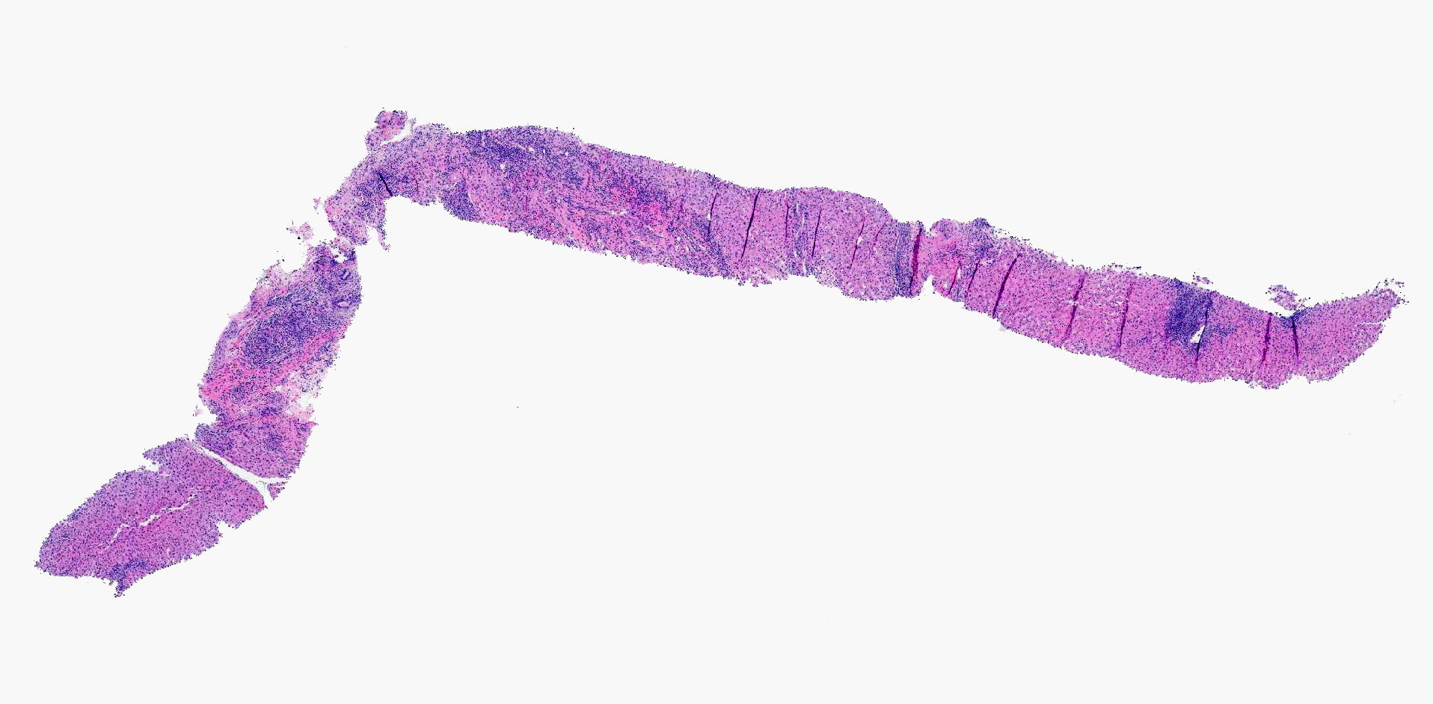

Slide 23
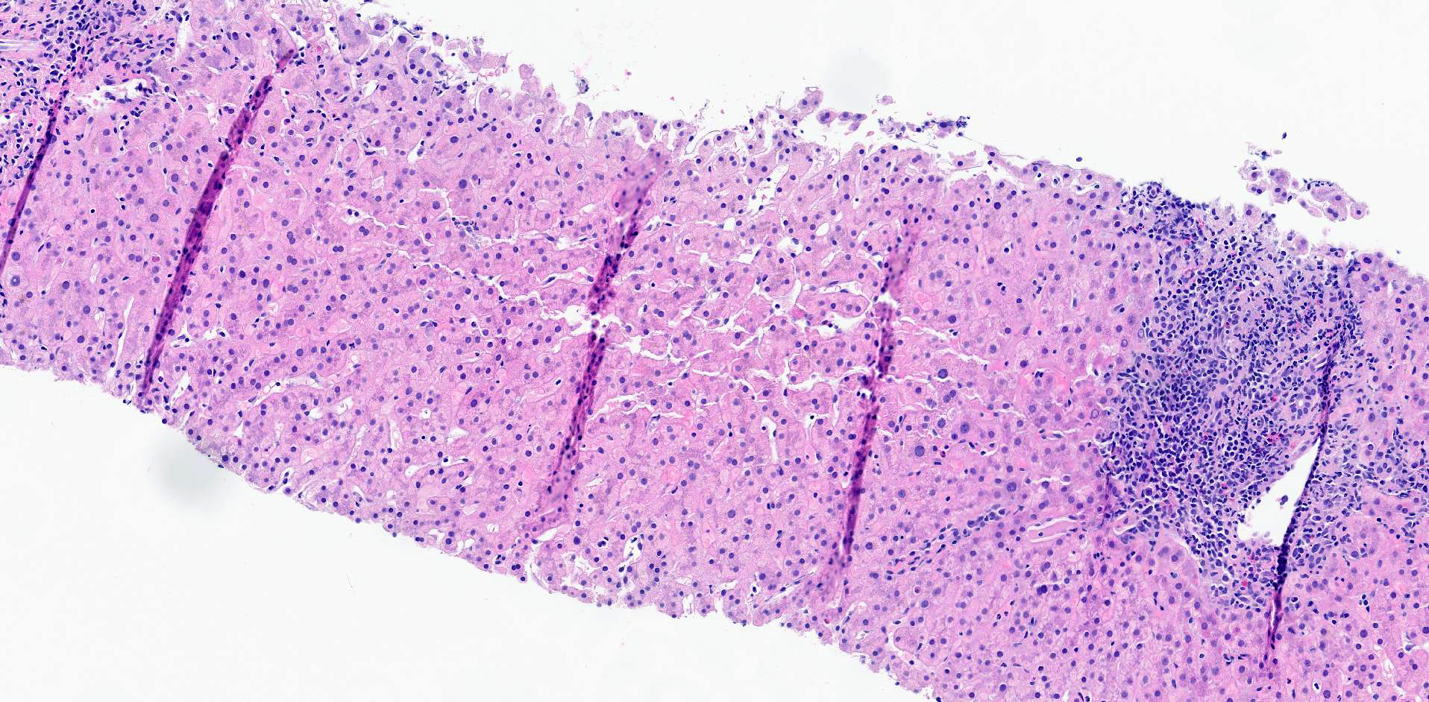

Slide 24
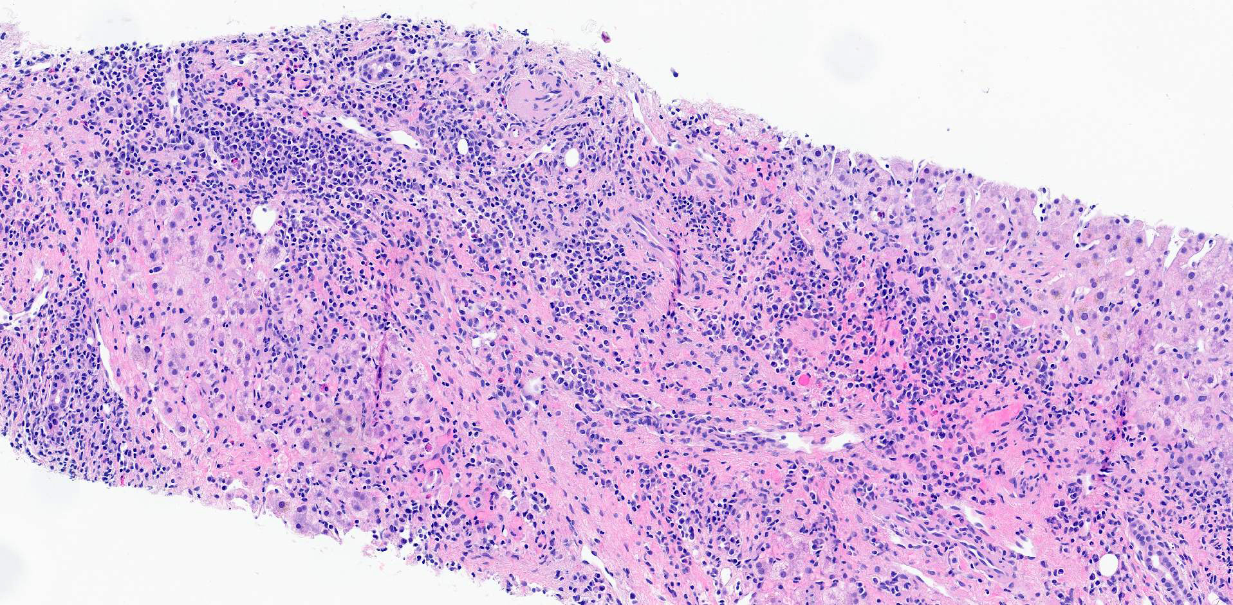

Slide 25
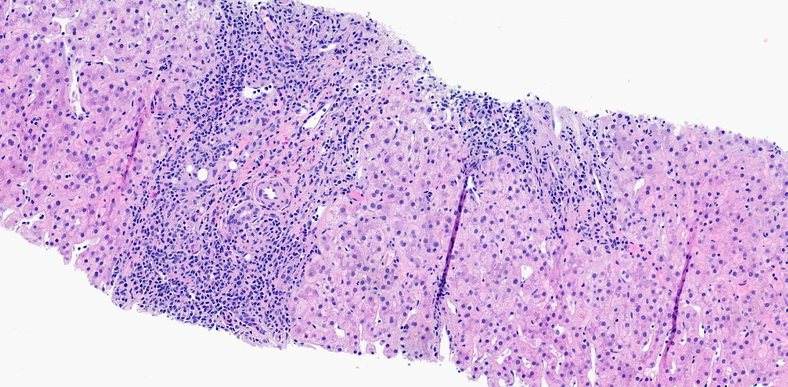

Slide 26
Case History
16-28781
Poor response to anti-rejection therapy
Porgression of metastatic disease
Patient expired of allograft failure and disease progression

Slide 27
Notes:
27 patients and 6 developed severe rejection

Slide 31
Incidence of ACR of 71.4% with less than 30 day washout since ICI use
Incidence of ACR of 12.9% with more than 30 day washout since ICI use
Plasmapheresis can be used to accelerate ICI clearance
70% of episodes of ACR are steroid resistant
Anti-thymocyte globulin can be used for rescue therapy
65% of episodes of ACR are successfully treated

Slide 32
Biopsy for diagnosis of DILI
Labs for patient management

Slide 33
obrigado(A)!

Slide 34
Thank you!

